Slide 1

Social Origins of female inventors in the us
By Megha Patel

Slide 2
Motivation
Goal 1: Find neighborhood effects that will increase the share of female inventors in the United States
Goal 2: Find Geographical Locations that are “hotspots” for female innovation
Benefits of This Study:
Increase in GDP
Enjoy higher levels of innovations
Greater diversity in STEM Fields
More Specific Public Policy Recommendations to encourage women in high patenting fields

Slide 3
Literature Review Sources
Jennifer Hunt - Labor Economist, Rutgers University
Patenting categories and fields that lack women in the field not due to their human capital accumulation (gap analysis, replication file not available)
Alexander Bell and Team – Opportunity Insights
Innovation Rates modeling to find effects that causes variation in human capital accumulation on the commuting zone level – Chosen to replication and extend
Ufuk Akcigit – Parallel Project
Historical macroeconomic trends (1900-1940) that affect the level of inventors in a region and state level validated to still exist in modern times
Phillippe Aghion – Parallel Project
Parental income and education models that show human capital accumulation is passed down to children
******Funnel System Approach to Literature Review, Large trends moving to smaller trends

Slide 4
1900-1940 General Golden Facts Estimated by Akcigit
Inventors were more educated on average and were most productive between the age of 36 and 55.
Father’s income and father’s education were highly correlated with becoming an inventor, especially through the effect on the level of a child’s education.
Inventors tend to marry later in life or not at all.
Broad measures of income inequality, such as the Gini coefficient, were negatively correlated with innovation at the state level
The top-1% income share had a U-shaped relationship with innovation.
Innovation hotspots tended to be financially independent and more geographically connected (higher levels of social cohesion)

Slide 5
Modern Times – Alexander Bell building on Akcigit
Neighborhood effects can measure the build up of human capital, but not as well as family or individual level characteristics
There are gender, technology, and race specific variations in inventor outcomes
New England, Pacific, and parts of the Midwest are innovation hubs, South not so much
Neighborhoods with higher levels of income, education, and access to STEM related networks had a higher probability of producing an inventor
Test scores from NYC public schools indicate that inventors score in the 90th percentile in 3rd grade (Ages 7-9) standardized tests

Slide 6
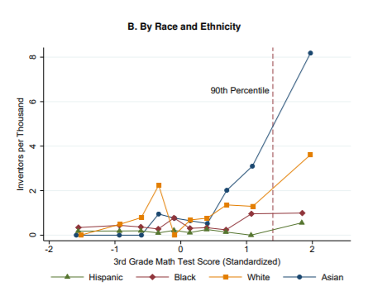
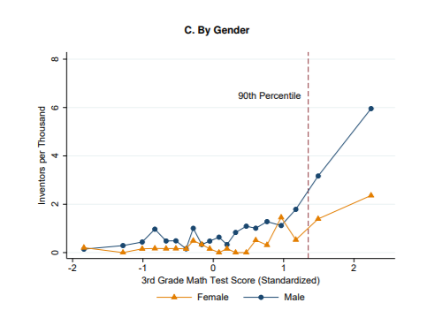
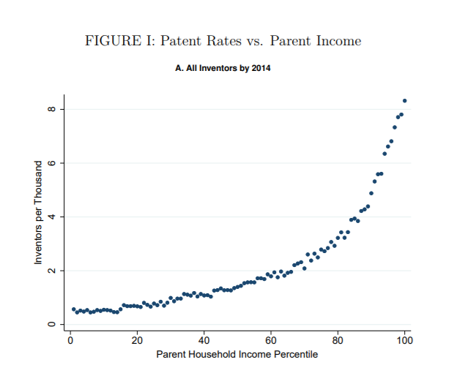
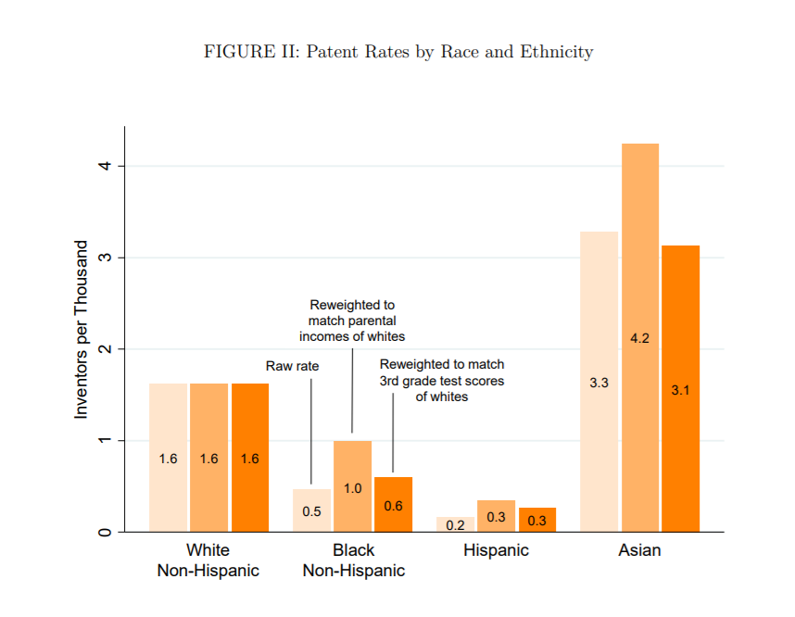

Slide 7
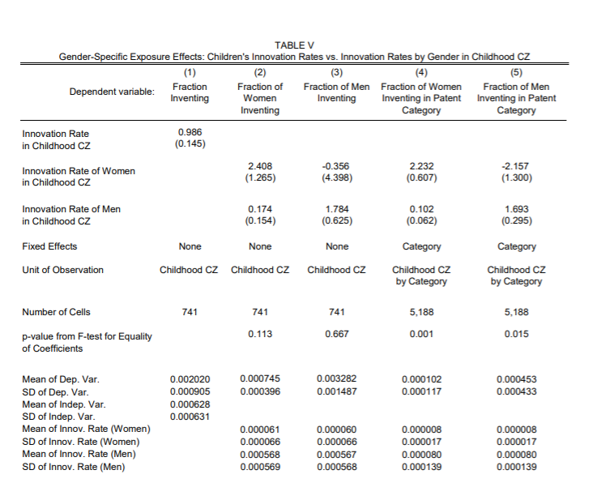
New Findings
children who grow up in the areas where the most innovation occurs tend to be most likely to go into innovation themselves
exposure to innovation during childhood through one’s neighbors increases a child’s propensity to innovate
, Their model “regress[es] the fraction of children who grow up to be inventors in each CZ on the patent rate of workers in their childhood CZ” to find innovation rates using simple OLS

Slide 8
Let’s do Micro -Jennifer Hunt’s Empirical Analysis on patenting categories and women’s outcomes
7.5% of patents granted were reported by female inventors
5.5% of commercialized or licensed patents, were reported by female inventors
Highly commercial patents: Electrical and Mechanical
62% in electrical engineering and mechanical engineering are commercialized.
Highly Non-Commercial: Life Sciences
Only 39% of patents granted in life sciences are commercialized
Majority of women patent in this category
Are intelligent, but not as highly intelligent as others in their fields: Less PhDs, more Masters
Model: Simple OLS

Slide 9
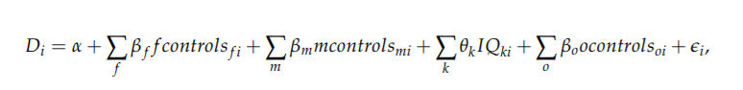
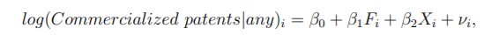
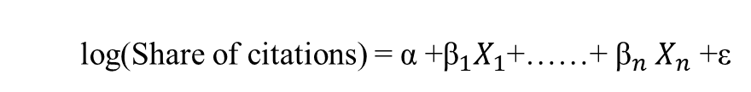
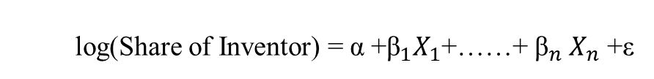
4 Distinct models: Same Concept
Macroeconomic Models
log(Share of citations) = α +${\text{β}}_{1}X_{1}$+……+ ${\text{β}}_{n} X_{n}$ +ε
log(Share of Inventor) = α +${\text{β}}_{1}X_{1}$+……+ ${\text{β}}_{n} X_{n}$ +ε
Final Model
Microeconomic Models

Slide 10
Variables/Factors of Interest Based on reading
Y – Inventors: Female, Male and then Total
X:
Family Measures – higher level data aggregate for family that measures disruption and marriage
Income Measures – Gini Coefficient, Top 1 Percent Income Share Squared, Household Income
Education Measures - Some measure of education on the CZ level
Social Measures
Labor Measures – Labor Force Participation Rate
Region or State level categorical as a control

Slide 11
Data Source
Opportunity Insights’ Patenting Data Set: https://opportunityinsights.org/data/
patenting outcomes for children born in 1980-1984 by the commuting zone using 1990 designation for GIS mapping
report the share of inventors and highly-cited inventors broken down by patent category
Classified as an inventor if he or she is listed on a patent application between 2001 and 2012 or grant between 1996 and 2014
Patenting categories use general USTPO designations. There are 7 distinct categories
Neighborhood effects (covariates) are sourced from online data tables (downloaded separately and merged with patenting data file upon the organization’s recommendation.)

Slide 12
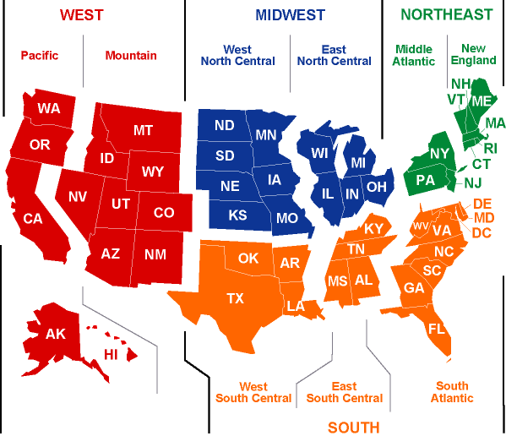
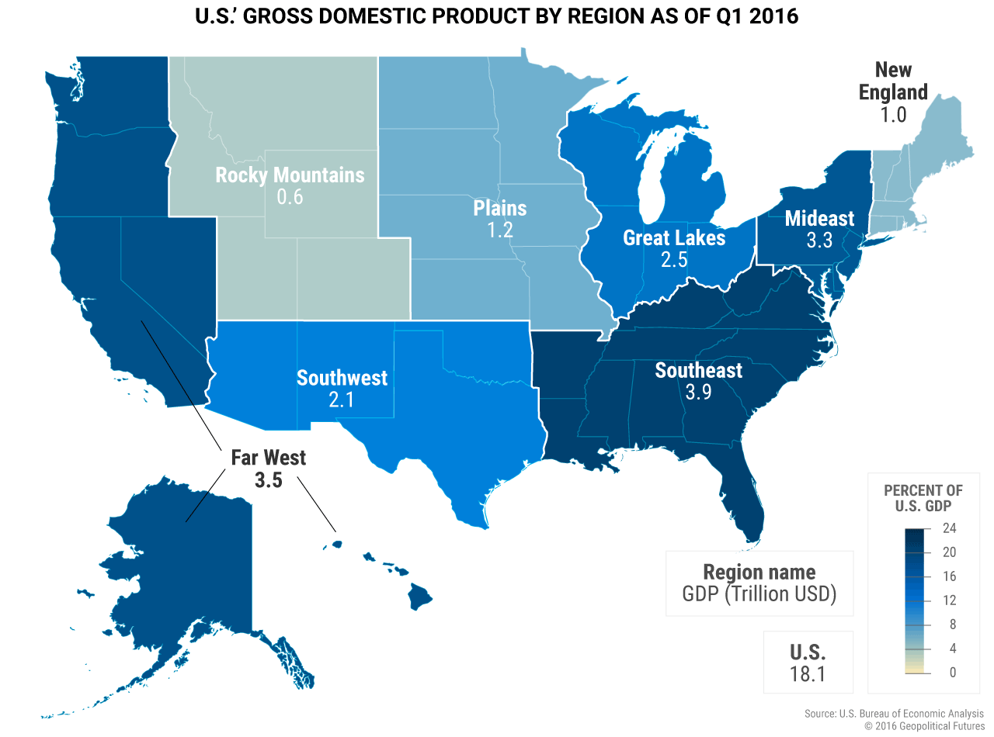
Let’s Do Geography: Part II
Source: EIA: U.S. Energy Information Administration
Source: Geopolitical Futures

Slide 13
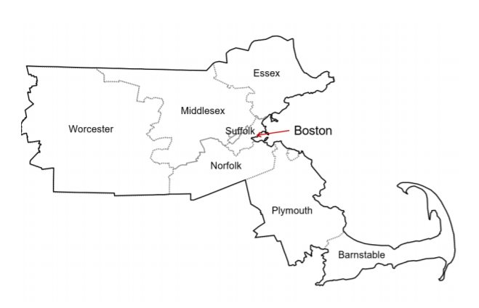
Refresher: Commuting ZOnes

Slide 14
Analysis Process
Descriptive Statistics – All Variables used
Round 1: Overall trends
GIS Mapping for Inventor Concentrations (Replication with Twist)
Regression Analysis – Share of Inventor (Total, Female, and Male) by neighborhood effects (Partial Replication with Twist)
Round 2: Female and Male Innovation Differences for Patenting Categories
GIS Mapping for Inventor Concentration by gender and patenting (Replication with Twist)
T-Tests – Difference between Share of Male and Female inventors in each patenting category

Slide 15
Descriptive Statistics
Inventor | Definitions | Obs | Mean | Std.
Total | Total fraction of inventors in US on Commuting Zone level | 570 | 1.705E-03 | 1.120E-03
Female | Total fraction of female inventors in US on Commuting Zone level | 570 | 5.674E-04 | 5.113E-04
Male | Total fraction of male inventors in US on Commuting Zone level | 570 | 2.820E-03 | 1.909E-03
*of the 741 total CZ, 570 contained the observations for each of the characteristics used in the analysis

Slide 16
Characteristics | Definition | Obs | Mean | Std.
Labor Force Participation | Share of people at least 16 years old that are in the labor force | 570 | 0.617208 | 0.0571443
Family with Single Mom | Number of single female households with children divided by total number of households with children | 570 | 0.211854 | 0.0498229
Tuition Adjusted* | Mean in-state tuition and fees for first-time, full-time undergraduates | 570 | 4.381642 | 3.750312
Marriage Rate | Fraction of people 15 or older who are married and not separated | 570 | 0.565646 | 0.0414323
Income Share of Top 1% Squared | The fraction of income within a CZ going to the top 1% defined within the CZ, computed using parents of children in the core sample. This value was squared | 570 | 143.0712 | 163.5047
Gini of Bottom 99% | Gini coefficient minus top 1% income share | 570 | 0.308328 | 0.0545287
Fraction Middle Class | Fraction of parents (in the core sample) whose income falls between the 25th and 75th percentile of the national parent income distribution | 570 | 0.543131 | 0.074369
Household Income per Capita Adjusted* | Aggregate household income divided by the number of people aged 16-64 | 570 | 32.97792 | 5.676666
Social Capital Index | Standardized index combining measures of voter turnout rates, the fraction of people who return their census forms, and measures of participation in community organizations | 570 | -0.023646 | 1.134388
State | Regions containing commuting zones in the United States | 570 | 30.15789 | 15.25114
*value was Divided by 1000 during analysis

Slide 17
Patent Category | Definition | Obs | Mean | Std.
Chemical*Male | General USTPO designation for patents in chemicals category then by gender | 570 | 2.455E-04 | 3.116E-04
Computers and Communications*Male | General USTPO designation for patents in computers category then by gender | 570 | 7.623E-04 | 6.914E-04
Drugs and Medical*Male | General USTPO designation for patents in life sciences category then by gender | 570 | 3.153E-04 | 4.012E-04
Electrical and Electronic*Male | General USTPO designation for patents in electrical category then by gender | 570 | 3.790E-04 | 4.751E-04
Mechanical*Male | General USTPO designation for patents in mechanical category then by gender | 570 | 4.331E-04 | 5.058E-04
Other*Male | General USTPO designation for patents that do not fit other categories then by gender | 570 | 5.183E-04 | 5.107E-04
Design and Plant*Male | General USTPO designation for patents in civil and general design categories then by gender | 570 | 1.662E-04 | 2.404E-04
Chemical*Female | General USTPO designation for patents in chemicals category then by gender | 570 | 7.330E-05 | 2.034E-04
Computers and Communications*Female | General USTPO designation for patents in computers category then by gender | 570 | 1.054E-04 | 1.745E-04
Drugs and Medical*Female | General USTPO designation for patents in life sciences category then by gender | 570 | 1.607E-04 | 2.603E-04
Electrical and Electronic*Female | General USTPO designation for patents in electrical category then by gender | 570 | 4.420E-05 | 1.019E-04
Mechanical*Female | General USTPO designation for patents in mechanical category then by gender | 570 | 4.000E-05 | 1.296E-04
Other*Female | General USTPO designation for patents that do not fit other categories then by gender | 570 | 5.183E-04 | 5.107E-04
Design and Plant*Female | General USTPO designation for patents in civil and general design categories then by gender | 570 | 5.030E-05 | 1.224E-04

Slide 18
Round 1: Overall Trends

Slide 19
Share of Inventors: Overall with all patenting categories

Slide 20
Subdivide by Gender
Female Share of Inventors
Male Share of Inventors
Darker areas have higher concentration of inventors
Inventors are concentrated in the New England Area, part of the Midwest, and Pacific
South and other parts of the Midwest do not have much innovation
Differences exist, but not as noticeable

Slide 21
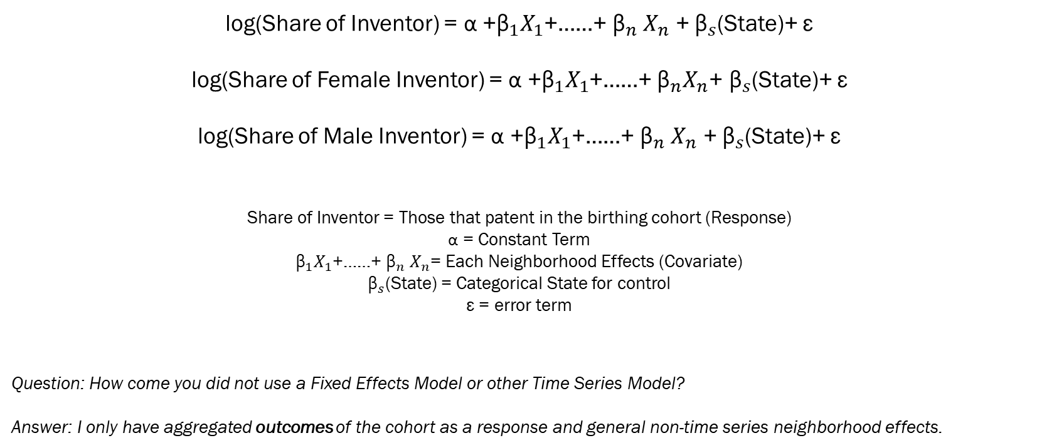
Regression Model: Multivariate Regression correcting for heteroskedasticity
log(Share of Inventor) = α +${\text{β}}_{1}X_{1}$+……+ ${\text{β}}_{n} X_{n}$ + ${\text{β}}_{s}$(State)+ ε
log(Share of Female Inventor) = α +${\text{β}}_{1}X_{1}$+……+ ${\text{β}}_{n}X_{n}$+ ${\text{β}}_{s}$(State)+ ε
log(Share of Male Inventor) = α +${\text{β}}_{1}X_{1}$+……+ ${\text{β}}_{n} X_{n}$ + ${\text{β}}_{s}$(State)+ ε
Share of Inventor = Those that patent in the birthing cohort (Response)
α = Constant Term
${\text{β}}_{1}X_{1}$+……+ ${\text{β}}_{n} X_{n}$= Each Neighborhood Effects (Covariate)
${\text{β}}_{s}$(State) = Categorical State for control
ε = error term
Question: How come you did not use a Fixed Effects Model or other Time Series Model?
Answer: I only have aggregated outcomes of the cohort as a response and general non-time series neighborhood effects.

Slide 22
 | Inventor | Inventor Female | Inventor Male
Labor Force Participation Rate | 0.187 | -2.099 * ** *** | 0.245
Family with Single Mom | -6.130 * ** *** | -4.930 * ** *** | -6.670 * ** ***
Tuition Adjusted | 0.003 | 0.004 | 0.003
Marriage | -6.501* ** *** | -6.549 * ** *** | -6.670 * ** ***
Top 1 Percent Income Share Squared | -1.188E-04 ** *** | -2.87E-04 | -8.70E-05
Gini of Bottom 99% | -1.152 ** *** | -4.161 * ** *** | -0.69
Fraction Middle Class | 1.037 ** *** | -1.450 * ** *** | 0.851
Household Income per Capita Adjusted | 0.054 * ** *** | 0.035 * ** *** | 0.050 * ** ***
Social Capital Index | 0.086 * ** *** | 0.113 * ** *** | 0.123 * ** ***
State | 0.005 * ** *** | 0.002 | 0.005 * ** ***
Constant | -3.850 * ** *** | -0.514 | -3.084 * ** ***
F Stat | 93.93 | 30.35 | 93.33
R Squared | 0.603 | 0.374 | 0.605
Root MSE | 0.44798 | 0.5251 | 0.44983
* 5% **10% ***15%

Slide 23
Correlations: Income Growth in CZ (GDP Growth?)
Inventor | Correlation Income Growth per Capita
Total | 0.1675
Male | 0.1723
Female | 0.0713
Female Inventors have a weak but positive correlation with income growth in the CZ
They receive lower salaries and are generally not inventors in highly commercialized patenting fields
There are also less female inventors overall

Slide 24
Round 2: Females and Patenting Categories

Slide 25
Geography of patents: Computers and Communications
Female Share of Inventors
Male Share of Inventors

Slide 26
Geography of patents: Drugs and Medical
Female Share of Inventors
Male Share of Inventors

Slide 27
Geography of patents: Electrical and Electronic
Female Share of Inventors
Male Share of Inventors

Slide 28
Geography of patents: Mechanical
Female Share of Inventors
Male Share of Inventors

Slide 29
Category | Difference (F-M) | SE | T Stat
Chemical | -1.551E-04 | 1.400E-05 | -11.054
Computers and Communications | -6.586E-04 | 2.880E-05 | -22.8931
Drugs and Medical | -1.629E-04 | 1.700E-05 | -9.563
Electrical and Electronic | -3.518E-04 | 2.130E-05 | -16.5096
Mechanical | -4.106E-04 | 2.390E-05 | -17.1687
Others | -4.194E-04 | 2.440E-05 | -17.1953
Design and Plant | -1.077E-04 | 3.471E-04 | -8.2

Slide 30
Conclusions (Reverse Funnel)
Female gaps in innovation are not due to lack of accumulation of human capital
I find that education measures are no significant in measuring the share of female inventors from a CZ.
Labor Measures were negative but significant for women inventors, and not significant to total inventors and male inventors.
Innovation Rates estimated by Bell prove that networks and mentoring increases female innovation

Slide 31
Conclusions (Reverse Funnel)
Category that contains the most females are related to life sciences and the least amount are computer/electrical
Hunt found this finding by conducting a gap analysis between female and male patent grantees for all seven patenting categories
I validated it by using a t-test as regression analysis on the commuting zone level will not yield useable results
My data does not distinguish between highly commercialized patents and non-commercial patents.

Slide 32
Conclusions (Reverse Funnel)
Neighborhood effects can predict the level of innovation in a commuting zone and imply factors that influence human capital build up
Factors that increase the likelihood of inventors are higher household incomes per capita, stronger communities, and lesser levels of income inequality
Human capital build up occurs in areas where people have access to higher quality education, stable family structures, less marriage, and higher levels of household income.
These factors match with some of Akcigit’s 16 golden facts
Fraction Middle Class? – Kuznets Curve

Slide 33
Public Policy Recommendations
Recommendation | Jennifer Hunt | Alexander Bell
Greater access to mentoring and networking | Yes | Yes
Increase Pay and Promotion opportunities for women | Yes | -
Address discrimination by manager and co-workers | Yes | -
Provide more full-time positions in STEM to women | Yes | -
Working conditions may not need to improve for women to stay in the field*. Whatever policies that improve work conditions will benefit both men and women equally | Yes* | -
Provide social programs and safety nets that can help increase income for lower income families and women | - | Yes
Increasing test scores and for young children | - | Yes
Don’t decrease income tax rates of the top earners (the top 1%) | - | Yes
Job training opportunities/ work-based programs for women | - | Yes
A redistribution of wealth can increase the level of innovation in a geographical area | - | Yes
Create environments that prevent women from leaving STEM fields early in their career | Yes | -
*This does not indicate that working conditions should not improve overall. For example, lab work that requires long hours can be completed by both men and women. However, if there is an opportunity to improve working conditions so that the lab work does not require long hours, it should not be because

